Slide 1
TESTING BASICS
Lecturer |  | Nam Hau

Slide 2
Objective
To understand the basics of testing
Appreciate the need for effective Testing
- If not tested properly, a software which can perform 100000 correct operations per second has the same ability to perform 100000 wrong operations per second.
Notes:
What is quality? High quality?
What is testing?
Dynamic/Static testing : www.guru99.com/static-dynamic-testing.html
Software Testing & Quality Certification Objectives: http://www.htinstitute.com/vendor/qai/software-testing-quality-certification-objectives
- Objectives <> Outline

Slide 3
Testing and Quality
Testing helps to measure the Quality of software in terms of Number of defects found
Tests also reveal important information regarding the Non functional attributes like Reliability, Security, Performance, etc.
Notes:
cũng tiết lộ thông tin quan trọng liên quan đến các thuộc tính chức năng như không đáng tin cậy, bảo mật, hiệu suất, vv

Slide 4
Contents
What is testing?
Importance of testing
Evolution of testing
Scope of testing
Risk based testing
Who does testing?
Attributes of a good tester
Common Testing Principles

Slide 5

Discussion
What do you believe Software Testing means?

Slide 6

What Is Software Testing?
Software Testing is a process where behavior is checked and observed against a specific expected behavior
HP Quality Process
Notes:
một quá trình mà hành vi được kiểm tra và quan sát đối với một hành vi mong đợi cụ thể

Slide 7

What Is Software Testing?
Software Testing is an investigation conducted to provide stakeholders with information about the quality of the product or service under test
http://en.wikipedia.org/wiki/Software_testing
Notes:
một cuộc điều tra tiến hành để cung cấp cho các bên liên quan thông tin về chất lượng của sản phẩm hoặc dịch vụ được thử nghiệm

Slide 8
What Is Software Testing?
The process of executing a program (or part of a program) with the intention of finding errors (G. J. Myers)
Software testing is the process of testing the functionality and correctness of software by running it
Testing is the process of exercising or evaluating a system or system component by manual or automated means to verify that it satisfies specified requirements (IEEE 83a)
The process of analyzing a system to detect the difference between existing and required conditions and to evaluate the feature of the system (IEEE/ANSI, 1983 [Std 829-1983])

Slide 9
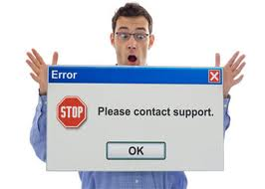
Bug
An Error found in the development environment before the product is shipped to the customer

Slide 10
Defect
A software defect is a general defined as a discrepancy between established software requirements and software functionality
Notes:
Defect is the difference between expected and actual result in the context of testing. Defect is the deviation of the customer requirement

Slide 11
Bug & Defect
Error
Bug
Defect
Development
Test
Shipped to
the customer

Slide 12
Causes of Software Defects
Minimal or no proper documentation of Business Requirements
Insufficient time window for development
Lack of domain knowledge
Programming Language constraints

Slide 13
Thinking
Why do you think testing is important?

Slide 14
Importance of Testing
Ensures that the product is usable
Ensures that Customer’s Objectives are met
Early detection of errors to prevents breakdown at a later stage
Ensures that the software is reliable
Builds Confidence in software
Increases Customer Satisfaction
Ensures effective execution in the given environment
Reduces overall cost of software
Reduces time for going live (production)

Slide 15
Bug Distributing
Test Time

Slide 16
Importance of Testing Early in the SDLC
Error removal cost over SDLC
Cost

Slide 17
Murphy’s testing laws
Every method you use to prevent bugs leaves a residue of subtler bugs against which those methods are ineffectual!
Software complexity grows to the limit of our ability to manage that complexity !
Notes:
Mỗi phương pháp bạn sử dụng để ngăn ngừa lỗi để lại một dư lượng lỗi tinh vi hơn so với những phương pháp đó là không hiệu quả!
Phần mềm phức tạp phát triển đến giới hạn của khả năng ma chúng tôi để quản lý duoc.

Slide 18
Impossible laws
Zero bug is impossible
Testing everything is impossible
Impossible !!!

Slide 19
Evolution of Testing @ Microsoft
Approach:
Up to late 1980s - Testing by developers, ad-hoc, some help from outside contractors
Since 1990/91 - Testing is a separate discipline, comparable to development
Milestones:
1984 - “Software test Engineers” - a new designation introduced
1984 - Separate testing group
1986 - Director of Testing (Dave Morre) of part time
1993 - Director of Testing ( Roger Sherman) full time
1995 - One tester for every developer

Slide 20
Software testing – The Past
Ad-hoc
Need-driven
Ignored completely
No theoretical basis i.e. No mathematical models etc
Totally manual
Testing jobs perceived as low scale as compared to other discipline

Slide 21
Software testing - Now !
Organized body of knowledge
Independent Testing teams
Testing Models
Testing knowledge Groups
A specialized engineering discipline in great demand
Testing industry grew by 750% from 2001 to 2003 and is expected to grow phenomenally
Commercial tools, Mathematical and scientific models available.
IEEE Standards, Certification programs like CSTE etc.
Automation solutions for the entire testing lifecycle

Slide 22
Project Scope
(realizing)
QA
BA

Slide 23
Scope of Testing
Let’s do exhaustive testing
Bad news : You can’t test everything
Good news: There is such a thing as “good enough”
Bad news : Good enough may cost too much
What do we do?
Increase focus via systematic process of elimination
What you might test?
Those areas which are within the scope of your project
What you should test?
The critical system functionality which effects the customers & users experience of quality
What you can test?
Estimate time & resource for risk driven effort

Slide 24
Risk Based Testing
Understand the application Risk from the customer’s or users experience to determine
What to test first?
How to prioritize testing?
What to test most?
How thoroughly to test each item?
What not to test?
“Understanding risk is the key to
dealing with inadequate test time allocated ”
Notes:
Sự hiểu biết rủi ro là chìa khóa để đối phó với viec khong duoc phan bo đầy đủ thời gian test

Slide 25
Risk Based Testing (cont)
Test critical quality risks
Optimum Test
Cost of Testing
“Understanding risk is the key to
Optimum testing”
Areas under test
Over Test
No. of defects

Slide 26
Other factors which influence the scope of testing
Contractual requirements
Legal requirements
Privacy related laws
Non-disclosure of identity
Industry-specific requirements
Aircraft safety equipment
“Understanding other related factors is also important to determine whether testing is enough”

Slide 27
Thinking
Can testing be replaced ?
Notes:
You got to be kidding !! – Ban dua ah?

Slide 28
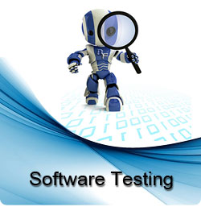
Who Typically Does?
Notes:
Soft DEV
BA
End Users
Support Staff

Slide 29
Discussion
What could go wrong with this typical approach to software testing?
Notes:
- DEV test? → go wrong?: chu quan,
- End users -> go wrong?.....
Những gì có thể đi sai với cách tiếp cận điển hình này để kiểm thử phần mềm?

Slide 30
Who should do?
Software testing, like software development, is a profession
Software testers employ unique skills sets to ensure software quality
Certifications levels were created by the International Software Testing Qualifications Board (ISTQB)

Slide 31
Need for independent Testing
Unbiased testing is necessary to objectively evaluate quality of a software
Developer carrying out testing would not like to expose defects
Assumptions made are carried into testing.
People see what they want to see.
More effective in terms of Quality & Cost.
“It takes an independent 3rd party to build confidence”
Notes:
Kiểm tra không thiên vị là cần thiết để đánh giá khách quan chất lượng của một phần mềm Phát triển thực hiện các thử nghiệm không muốn để lộ các khuyết tật Giả định cũng được đưa vào thử nghiệm. Mọi người nhìn thấy những gì họ muốn xem. Hiệu quả hơn về chất lượng và chi phí.

Slide 32
Quality Assurance & Control
Quality Assurance (QA) is a set of processes designed to ensure the developed product satisfies customer requirements in a reliable fashion
Quality Control (QC) is a set of procedures designed to ensure a product adheres to a set of quality criteria and meets the client or customer requirements
Notes:
(QA) là một tập hợp của các quá trình duoc thiết kế để đảm bảo rang: Sản phẩm được phát triển thoa man yeu cau KH một cách đáng tin cậy
(QC) là một tập hợp các thủ tục được thiết kế để đảm bảo một sản phẩm tuân thủ một tập hợp các tiêu chí chất lượng và đáp ứng các khách hàng hoặc khách hàng yêu cầu

Slide 33
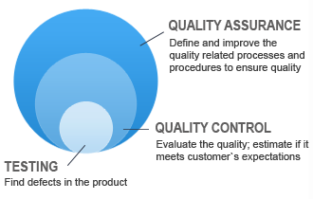
Quality Assurance & Control (cont)
Notes:
QC: Emphasizes testing and ensuring the release is defect free
QA: Emphasizes improving associated processes to prevent defects from happening

Slide 34
Thinking
What do you think should be attributes of a good test engineer?
Notes:
nghịch lý cua Testing

Slide 35
Attributes of a good tester
A good test engineer has a 'test to break' attitude
Need to take a different view, a different mindset (“What if it isn’t?”, “What could go wrong?”)
An ability to understand the point of view of the customer
A passion for quality and attention to detail
Notice little things that others miss/ignore (See symptom not bug)
Ability to communicate fault information to both technical (developers) and non-technical (managers and customers)
Tact and diplomacy for maintaining a cooperative relationship with developers
Work under worst time pressure (at the end)
“Patience”
Notes:
Một kỹ sư kiểm tra chất lượng phải có thái độ 'thử nghiệm để phá vỡ’ Cần phải có một cái nhìn khác nhau, một suy nghĩ khác nhau ("Nếu nó không?", "Điều gì có thể đi sai?") Một khả năng để hiểu quan điểm của khách hàng Một niềm đam mê cho chất lượng và sự chú ý đến từng chi tiết Chú ý những điều nhỏ nhặt mà những người khác bỏ lỡ / bỏ qua (Xem triệu chứng không lỗi) Khả năng giao tiếp thông tin lỗi cho cả hai kỹ thuật (nhà phát triển) và phi kỹ thuật (nhà quản lý và khách hàng) Và khéo léo để duy trì một mối quan hệ hợp tác với các nhà phát triển Làm việc dưới áp lực thời gian tồi tệ nhất (ở cuối) "Kiên nhẫn"

Slide 36
Testing roles
Manager
PM
Scope
Cost
Project
Time
Quality
Customer
Employee
Organization

Slide 37
Common Definition
Baseline
Methodology
Process
Procedure
Software Build
Releases and Cycles
User Case
Test Case
Test Script and Test Suite
Benchmark

Slide 38
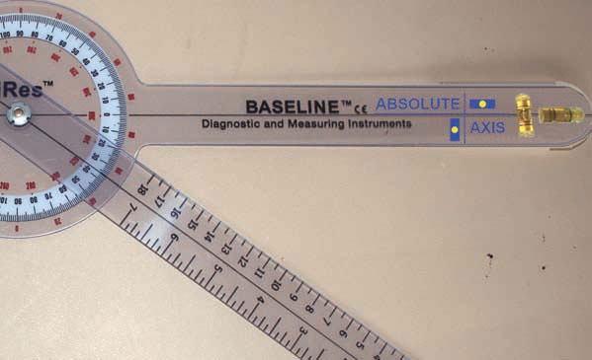
Baseline
A baseline is defined as a single set of data that has been captured for purposes of measuring improvement
Notes:
tập hợp các dữ liệu đã bị thu thap vì mục đích đo lường sự cai tiến

Slide 39

Methodology
A methodology is a defined set of methods collected to accomplish a goal

Slide 40
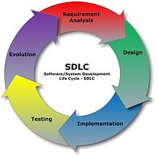
Process
A process, in terms of software methodology, is a set of related tasks which are compiled to accomplish a goal

Slide 41

Procedure
A procedure, is a set of actions, operations, or methods which are executed the same way each time in order to obtain the same result

Slide 42
Software Build
Software Build is a version of a program that is still in the implementation stage. Builds are typically given an identifier called a build number
Notes:
một phiên bản của một chương trình mà vẫn còn trong giai đoạn thực hiện.
Builds thường được đưa ra một định danh được gọi là build number

Slide 43
Releases and Cycles
A Release is a packaged distribution of a particular version of software
A testing cycle is a defined phase of testing to accomplish a set of a goals during the SDLC

Slide 44

Benchmark
A benchmark is a standard by which something is evaluated or measured

Slide 45
User Case
A user case is a technique to capture the functional requirements of a system. It uses actors/roles and events to represent business functionality

Slide 46
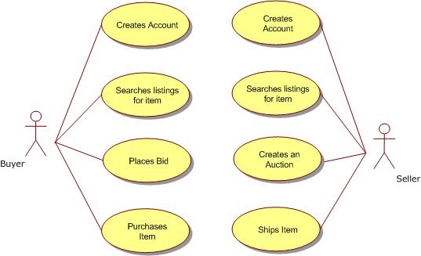
User Case Example

Slide 47
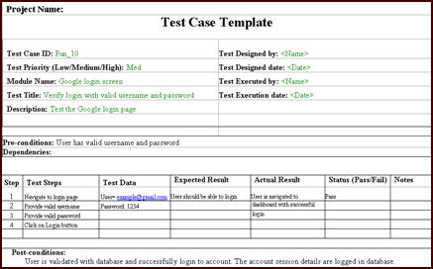
Test Case
A test case is a set of conditions and variables built to determine if software meets expected criteria
Notes:
một tập hợp các điều kiện và các biến được xây dựng để xác định các tiêu chí nếu phần mềm đáp ứng mong đợi

Slide 48
Test Script and Test Suite
Test Script are test cases that are manual or automated
Test Suite, or validation suite, is a collection of test cases design to conduct and validate a business process.
Notes:
một tập hợp các trường hợp thử nghiệm thiết kế để thực hiện và xác nhận một business process

Slide 49
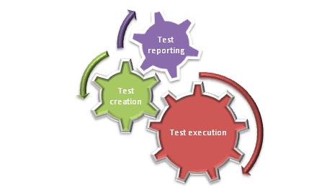
Test Framework
A test framework is a set of concepts, methodologies and tools to support the software testing effort

Slide 50
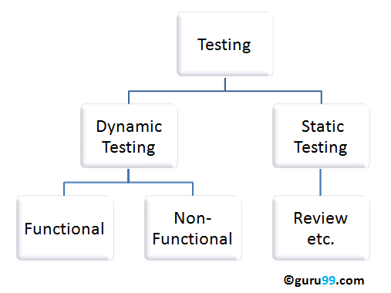
Static & Dynamic Testing

Slide 51
Static & Dynamic Testing (cont)
Static Testing | Dynamic Testing
Testing done without executing the program | Testing done by executing the program
This testing does verification process | Dynamic testing does validation process
Static testing is about prevention of defects | Dynamic testing is about finding and fixing the defects
Static testing gives assessment of code and documentation | Dynamic testing gives bugs/bottlenecks in the software system.
Static testing involves checklist and process to be followed | Dynamic testing involves test cases for execution
This testing can be performed before compilation | Dynamic testing is performed after compilation
Static testing covers the structural and statement coverage testing | Dynamic testing covers the executable file of the code
Cost of finding defects and fixing is less | Cost of finding and fixing defects is high
Return on investment will be high as this process involved at early stage | Return on investment will be low as this process involves after the development phase
More reviews comments are highly recommended for good quality | More defects are highly recommended for good quality.
Requires loads of meetings | Comparatively requires lesser meetings

Slide 52
Common Testing Principles
Exhaustive testing is not possible
Testing is a problem of economics
All tests should be traceable to customer requirement
Test should be planned long before testing begins
The Pareto principle applies to software testing
“80 percent of all the errors uncovered during testing will likely be traceable to 20 percent of all program modules”
To be most effective, testing should be conducted by an independent third party

Slide 53
Summary
In this module, you learned about:
What is? Why need? Who does?
Software Testing
The Evolution of Software Testing
How to scoping the Software Testing?
Common Testing Principles

